Slide 1
Welcome to the P233Q Family
Highlights for incoming students

Slide 2
History
P233Q was established in the 1970’s
We are a specialized school serving students with disabilities located within District 75.
We serve students ranging in grades K through age 21 and have 9 different “site” locations.
P233Q consists of 3 elementary schools, 3 middles schools and 3 high schools.
We have over 500 students in a variety of different classroom settings (12:1:4, 6:1:1, 8:1:1, 12:1:1 and inclusion)
P233Q specializes in providing services based off of student’s individualized Education Plan including related services, PBIS interventions, IEP accommodations, parent trainings and much more.

Slide 3
P233Q’s Mission and Vision

Slide 4
We are a ROAR school! GO lions!!!
We believe all students learn best in a respectful, supportive environment where they take ownership of their work, always feel safe and there is a shared responsibility for success.

Slide 5
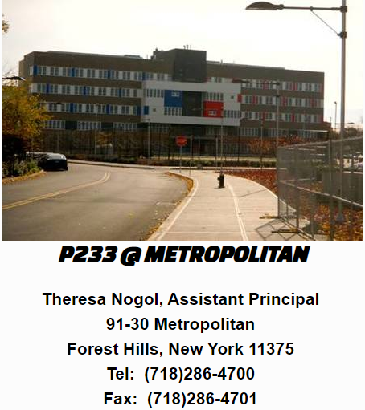
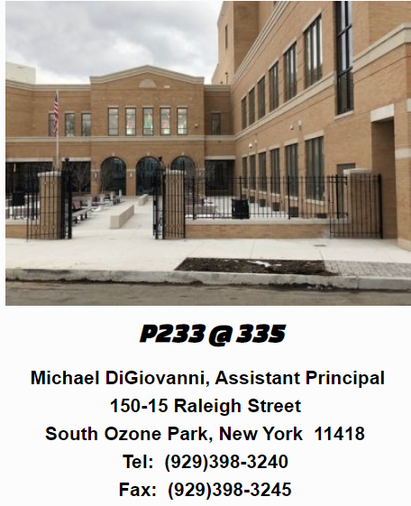
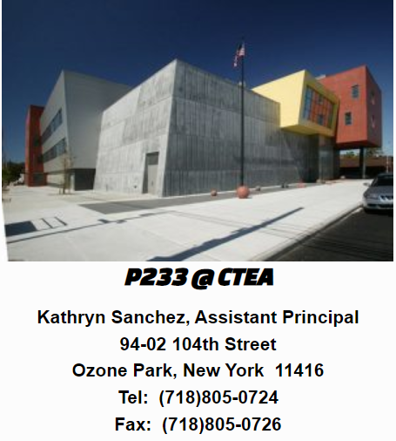
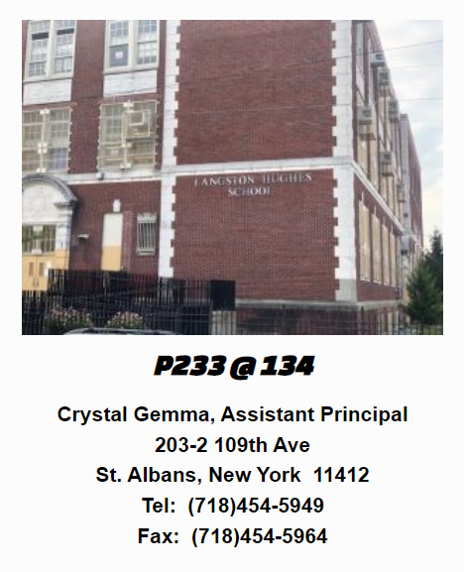
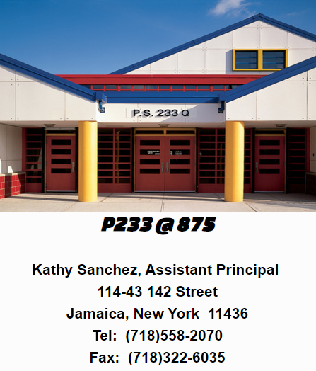
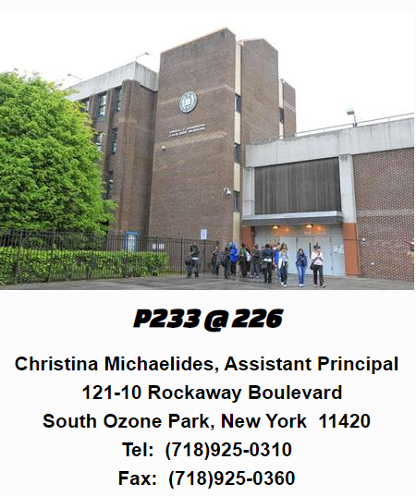
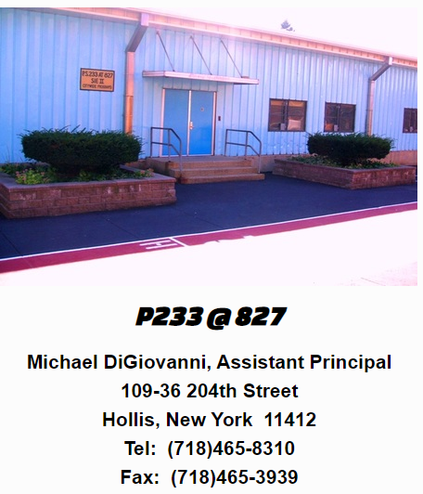
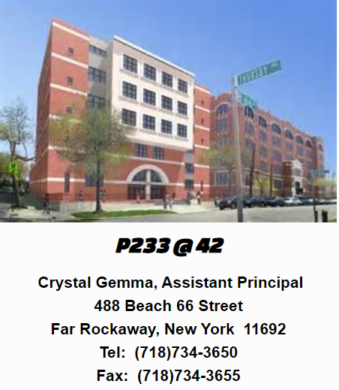
Locations: We have 9 locations throughout Queens, NY

Slide 6
Elementary Sites and Services
P233Q offers a variety of different program and curriculums for our elementary aged students (Grades K-5).
Our elementary schools consist of 6:1:1, 8:1:1 and 12:1:1 classroom ratios, both standardized and alternate.
Students are provided all services identified on their IEP including speech and language therapy, Occupational Therapy, Physical Therapy, Counseling, Hearing Services and Vision Services.
Some of the educational extras offered at our sites are Dance/Movement, Music, Cooking, Adaptive Physical education, and Creative Arts (site specific).

Slide 7
Elementary Curriculums and Programs
Program Type | Math | ELA | Science | Social Studies
8:1:1 & 12:1:1 Standardized Class (Student participating in the NYS exams) | HMH Go Math | HMH Journey’s Head-Sprout online Reading Fountas and Pinnell/Guided Reading (model) | HMH Science Dimensions | P233Q Curriculum using and the NYC scope and sequence NYC Passport
12:1:1, 8:1:1, 6:1:1 | HMH Go Math Attainment’s Early Numeracy | P233Q’s Units of Study Head-Sprout online Reading Fountas and Pinnell/ Guided Reading using A-Z /P233Q’s Focus on Phonic and Grammar SMILE (structured method in language education) reading program Core Vocabulary | P233Q Curriculum – Scope/Sequence | P233Q Curriculum using and the NYC scope and sequence NYC Passport
Social Emotional Learning: Rethink and PBIS

Slide 8
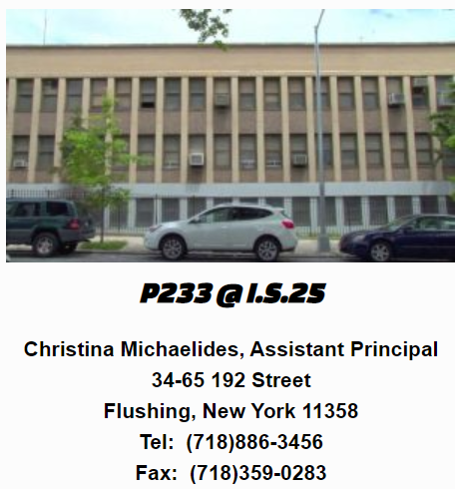
Middle School Sites and Programs
P233Q offers a variety of different program and curriculums for our Middle school aged students (Grades 6-8).
Our Middle schools consist of 6:1:1 and 12:1:4 classroom ratios.
Students are provided all services identified on their IEP including speech and language therapy, Occupational Therapy, Physical Therapy, Counseling, Hearing Services and Vision Services.

Slide 9
Middle School Curriculums and Programs
Program Type | Math | ELA | Science | Social Studies
6:1:1 | AbleNet Equals | P233’s Units of Study Fountas and Pinnell/ Guided Reading using A-Z /Focus on Phonic and Grammar SMiLE | P233Q Curriculum – Scope/Sequence | P233Q Curriculum using and the NYC scope and sequence NYC Passport
12:1:4 | AbleNet Equals | AbleNet STEM | P233Q Curriculum – Scope/Sequence | P233Q Curriculum using and the NYC scope and sequence NYC Passport
Social Emotional Learning: Rethink and PBIS

Slide 10
High School Sites and Programs
P233Q offers a variety of different program and curriculums for our High School aged students (Grades 9 – age 21).
Our High Schools consist of 6:1:1, 12:1:4, 12:1:1 and inclusion programs.
Students are provided all services identified on their IEP including speech and language therapy, Occupational Therapy, Physical Therapy, Counseling, Hearing Services and Vision Services.
Some of the educational extras offered at our sites are Cooking shop, print shop, school counsel, Library services, and more(site specific). Our over 18 students have the opportunity to participate in job site programs and career trainings.

Slide 11
High School Curriculums and Programs
Program Type | Math | ELA | Science | Social Studies
12:1:1 | Attainment Budgeting | HMH System 44/Literature* Rigor- – Benchmark Education | P233Q Curriculum – Scope/Sequence | P233Q Curriculum using and the NYC scope and sequence NYC Passport
6:1:1 | AbleNet Equals | SMiLE * AbleNet STEM | P233Q Curriculum – Scope/Sequence | P233Q Curriculum using and the NYC scope and sequence NYC Passport
12:1:4 | AbleNet Equals | AbleNet STEM | P233Q Curriculum – Scope/Sequence | P233Q Curriculum using and the NYC scope and sequence NYC Passport
18+ | Attainment Budgeting | Rigor – Benchmark Education | P233Q Curriculum – Scope/Sequence | P233Q Vocational Curriculum (Brigance)
Social Emotional Learning: Rethink and PBIS

Slide 12
Phone conferences can scheduled for more information
Please use the below email list to schedule
Site | Assistant Principal | Email Address
Metro | Terri Nogol | Tnogol@schools.nyc.gov
CTEA | Kathryn Sanchez | KSanche2@schools.nyc.gov
875 (HS) | Kathryn Sanchez | Ksanche2@schools.nyc.gov
226 | Christina Michaelides | Cmichae3@schools.nyc.gov
IS 25 | Christina Michaelides | Cmichae3@schools.nyc.gov
827 (Hollis) | Michael DiGiovanni | Mdigiovanni@schools.nyc.gov
335 | Michael DiGiovanni | Mdigiovanni@schools.nyc.gov
42 | Crystal Gemma | Cgemma@schools.nyc.gov
134 | Crystal Gemma | Cgemma@schools.nyc.gov

Slide 13
Visit:
P233q.com
for more information about our program and services.

